Slide 1
Subtopic N3.8 - Short Division (with carrying)
LEARNING OUTCOME: To understand how to apply short division to solve problems.
Keywords:
Divide
Share
Dividend
Divisor
Objectives:
To be able to use short division where carrying is required.
To be able to use short division to solve problems in context.
Introduction – read and annotate:
In this subtopic, you’ll tackle short division problems that involve carrying. This will help you deepen
your understanding of place value and prepare you for more challenging division, including with
remainders or decimal answers.
Definition
Characteristics
Splitting a number into equal parts.​
Involves two numbers: dividend and divisor.
The result of division is called the quotient.
Division can result in a whole number, a fraction, or a decimal, depending on the numbers involved.
Division is denoted by the symbol "÷" or the fraction bar "⁄"
Examples
Division
Non - Examples
10 ÷ 2 = 5
8 ÷ 4 = 2
21 ÷ 7 = 3
1.5 ÷ 0.5 = 3
Addition and subtraction are not division operations.
Multiplication is the inverse of division but is a different operation.
Ratios and proportions are related concepts but are not division.
Short division with carrying
Example 1 – I do…
Example 2 – We do…
Example 3 – You do…
Steps
1) Set out the short division, making sure the divisor is on the outside. 2) Starting from the left, divide into each digit, carrying where necessary.
14
114
152

Slide 2
Example 4 – I do…
Example 5 – We do…
Example 6 – You do…
Steps
1) Set out the short division, making sure the divisor is on the outside. 2) Starting from the left, divide into each digit, carrying where necessary.
1525
572
2732
Independent Practice
Question 1. Calculate:
14
24
12
112
224
223
218
219
2319
2313
1159
1545
1546
129
126
1569
27647
81533

Slide 3
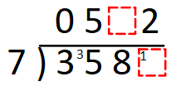
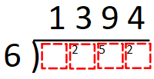
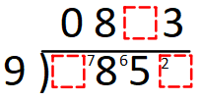



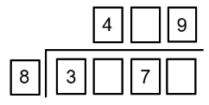
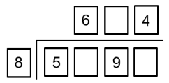
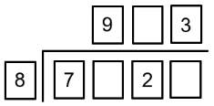
a) | b) | c)
d) | e) | f)
Question 2. For the following questions, fill in the blanks.
Question 2. For the following questions, fill in the missing blanks.
1
7
4
8 3 6 4
7
7
5
7
5
6
2
3
2
6
4
Question 3. A toy costs £6. Over a week, a shop makes £162 from selling the toy. How many toys were sold? | Question 4. A group of 3 friends take a journey in a taxi. The total cost of the journey is £72. The friends share the cost equally. How much does each person pay? | Question 5. A journey lasts 119 days. How many weeks is this?
27
£24
17
Question 6. A school has 5-year groups and 835 students in total. Each year group has an equal number of students. How many students are in each year group? | Question 7. Miss Jenkins has 18 bags of sweets. Each bag contains 30 sweets. Miss Jenkins shares as many sweets as possible equally among her 9 classes. How many sweets do each class get? | Question 8. James hired a holiday cottage for 7 days for £406. Ben hires the same cottage, at the same price per day, for 10 days. How much will this cost Ben?
167
60
£58

